Slide 1






SENTIMENT ANALYTICS ON AUTOMOTIVE SECTOR
IPBA CAPSTONE PROJECT – GROUP 1
Rahul Anand
Thoram Srikanth
Archana Kumari
Rahul Sivarajan
Dinesh Kumar
Dalavendra Pratap Singh

Slide 2
Agenda
Executive Summary
Project Timeline
Data Scraping
Data Processing & Exploratory Data Analysis
Twitter Analysis
Bajaj Auto
Royal Enfield
Hero MotoCorp
Honda Motorcycles
TVS Motors
Suzuki Motors
Topic Modeling
Conclusions

Slide 3
Executive Summary (1/2)
Purpose
The study was conducted to perform and present a competitive market analysis, for our client, to reflect the changes in consumer perception and buying behaviour post COVID-19 in India for the following motorcycle brands:
Bajaj Autos
Eicher Motors
Hero MotoCorp
Honda Motorcycles
TVS Motors
Suzuki Motors
Approach
Social media platforms such as Twitter, YouTube and other online platforms were scraped to gather and consolidate public reviews about each brand. We have divided the data scrapped from twitter into - official tweets and general tweets, based on the twitter characteristics. The idea behind the categorisation was to understand the official messaging vis-à-vis the general public sentiment.
Overview

Slide 4
Executive Summary (2/2)
Challenge
We went about understanding the sentiment and the priorities of the customers and how it has changed over the period from pre-covid till now. In order to do that the data was collected from Twitter for each assigned brands. The data was scraped using the most appropriate guided techniques to ensure that only the data pertaining to the brand (official and verified accounts) are captured.
The relevance of the Twitter data was stark and incomprehensible. One of the reason being the vagueness of the information and the lack of specificity (as we were looking at the overall brand in general). Thus even after performing the hashtag analysis or topic modelling we weren’t able to draw a conclusive theme from the data.
Solution and Highlights
In order to overcome this issue, we decided to take a two-phase approach, which involved a Hashtag Analysis of the Official Tweets and Public sentiment analysis over the period (for the rest of the tweets). This was helpful in understanding the official messaging and how the public sentiments varied over the target period. We observed the following conclusive findings related to the brands:
Market position of Hero, Honda, Bajaj, and Honda did not change due to COVID. Although Royal Enfield’s and Suzuki’s market position has relatively gone back and forth, it remained well below other major brands. We anticipate similar trends continuing for the next three months.
The market campaigning of some of the brands were aligned with public sentiments as projected in our analysis. The brands that were quick to adopt public perception also witnessed increased volume in sales – Gixxer (Suzuki); Hornet (Honda); Xpulse (Hero).
Majority of the brands have outperformed their previous year sales since September 2020. It is interesting to note that September has also been the month when the tweet volume for most brands reached pre-covid levels.
Highlights

Slide 5
Project Timeline
Phase 1
Sep 2020
Phase 2
Oct 2020
Phase 3
Nov 2020
Phase 4
Dec 2020
Data Scraping & Processing
Exploratory Data Analysis
Sentiment Analysis
& Topic Modeling
Two-step Solution: Official Hashtag and Public Sentiment Analysis
Phase 1
*Extract data from the web for each brand. The data was sourced from multiple sources including Twitter, YouTube and online website
Phase 2
Exploration of data i.e., Tweets, to streamline the data and identify the most appropriate techniques required to carry out the analysis
Phase 3
Perform sentiment analysis on the extracted features to identify general sentiment, trends and/or biases if any. Topic modelling was initiated to extract the common themes
Phase 4
The final/solution phase comprised of identifying the relevant themes and topics that emerged as priorities for the customer and the company. This was performed using two-step approach
*Our data is pertaining to the period: Jul 1, 2019 – Feb 29, 2020(Pre-Covid), and Mar 1, 2020 – Present (Post-Covid)

Slide 6







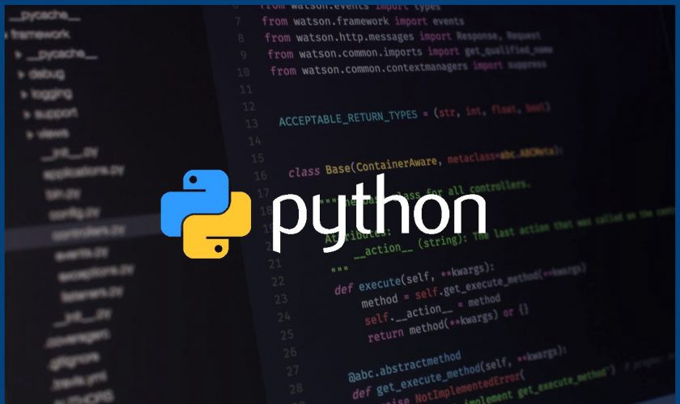
Data Scraping
Data Sources
Process Workflow
Master Data
Tweet ids
Hashtag keywords
Pre-covid tweets
Batch processing of 50 tweet ids. Uses ‘api.statuses_lookup’ function
Post-covid tweets
Snscrape
Tweet ids
Tweepy API
Tweet attributes
Unique Tweets
Tweets from official twitter handle – brand
Web Scraping
YouTube urls (manually selected)
Duplicate records (based on id) and records that fall outside of the date range were removed
Tweets from official twitter handle – customer
Web Scraping
English comments were filtered using ‘langdetect’ library
Selenium
Pre-covid comments
YouTube API
Comment attributes
English comments
Unique Comments
YouTube OAuth2.0
Post-covid comments

Slide 7
Data Processing & Exploratory Data Analysis
Removes usermentions, hashtags, emoticons, hyperlinks, and other miscellaneous characters
DATA PROCESSING WORKFLOW
Remove
nltk stopwords
&
User-selected words
Import into a DataFrame
Apply Regular Expressions
Snowball Stemmer
Processed
Tweets /Comments
Tweet Attributes
Tweet ID
Date Posted
Tweet Text
Hashtags
User Mentions
YouTube Comment Attributes
Video ID
Comment ID
Published Date
Comment Text
 | Tweets |  |  | YouTube Comments
Analysis Type | Pre-covid | Post-covid | Combined | Pre-covid | Post-covid | Combined
Daily count plot |  |  | ● |  |  | ●
Monthly count plot |  |  | ● |  |  | ●
Bar plot of "all time top 25 hashtags" |  |  | ●
Monthly popular hashtags |  |  | ●
Word clouds | ● | ● | ● | ● | ● | ●
Frequency distributions | ● | ● | ● | ● | ● | ●
Bigrams | ● | ● | ● | ● | ● | ●
Sentiment histogram | ● | ● |  | ● | ●
Sentiment variation with time |  |  | ● |  |  | ●
Sentiment count plots | ● | ● | ● | ● | ● | ●
Sentiment pie charts | ● | ● |  | ● | ●
Word clouds based on sentiment | ● | ● | ● | ● | ● | ●
Frequency distributions based on sentiment | ● | ● | ● | ● | ● | ●
Bigrams based on sentiment | ● | ● | ● | ● | ● | ●
Trigrams based on sentiment | ● | ● | ● | ● | ● | ●
Noun frequency distribution using NLTK POS tagging | ● | ● |  | ● | ●
Topic Modeling | ● | ● | ● | ● | ● | ●
*Cost-Benefit Analysis (Multivariate Analysis) |  |  | ●
EXPLORATORY DATA ANALYSIS
*Cost benefit analysis was performed using tweets and sales data

Slide 8
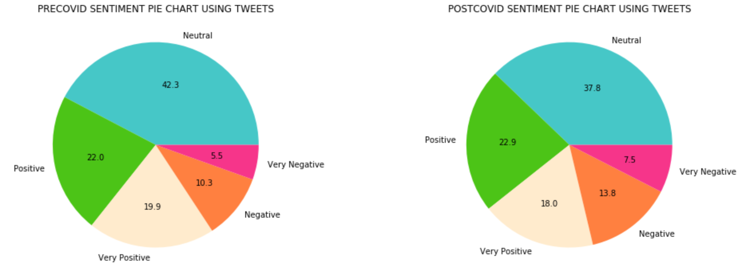
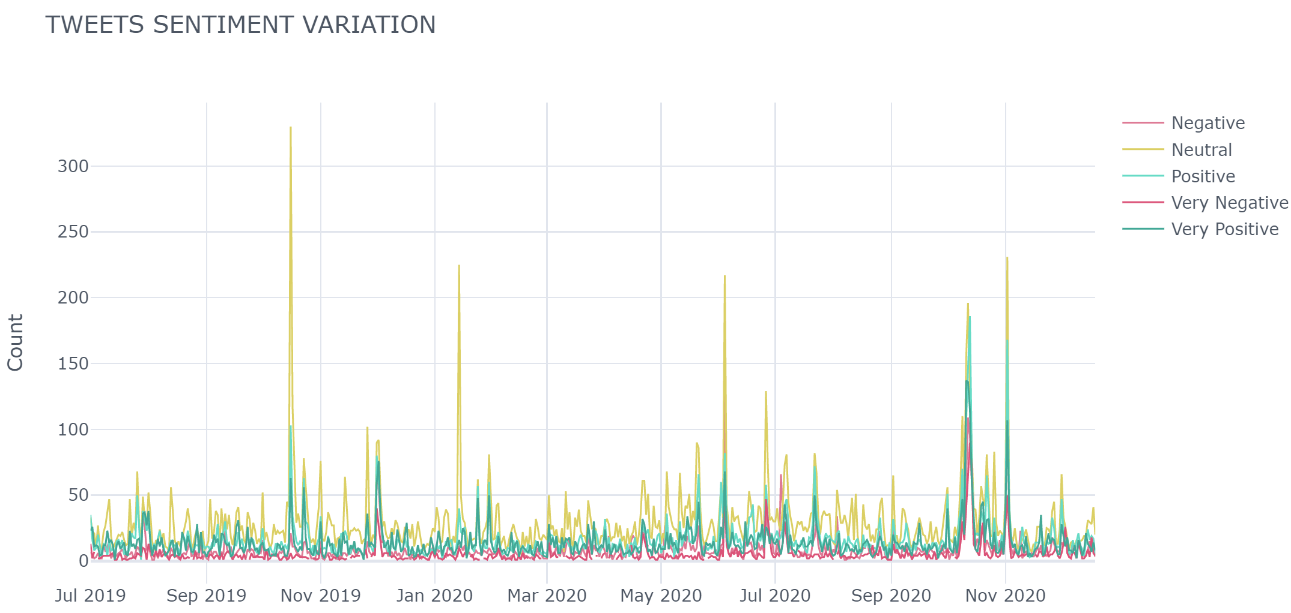
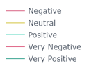
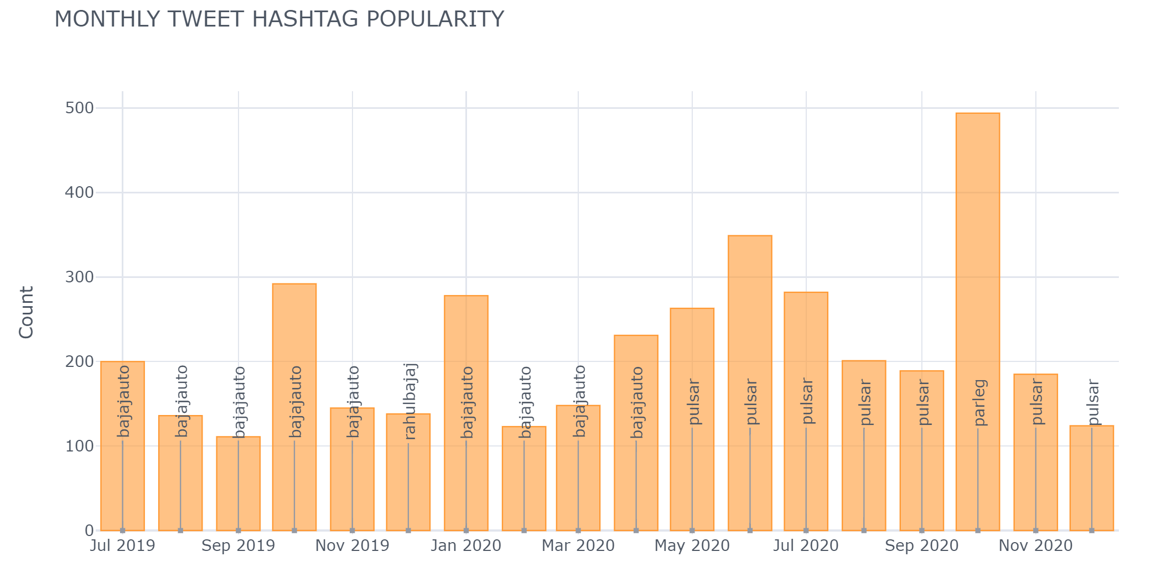
Bajaj Auto – Twitter Analysis (1)
TWEET SENTIMENT VARIATION WITH TIME
MONTHLY TWEET HASHTAG POPULARITY
Key Observations
Pre Covid: Tweets from Official handle mostly talks Bajaj auto products
Post Covid: Sales of some of the company’s high-end products such as Pulsar has picked up.
Post Covid: There is price hikes that have come about as a result of BS-VI
Post Covid: Bajaj Auto has recovered quite well comparing Pre Covid comparing other brands

Slide 9
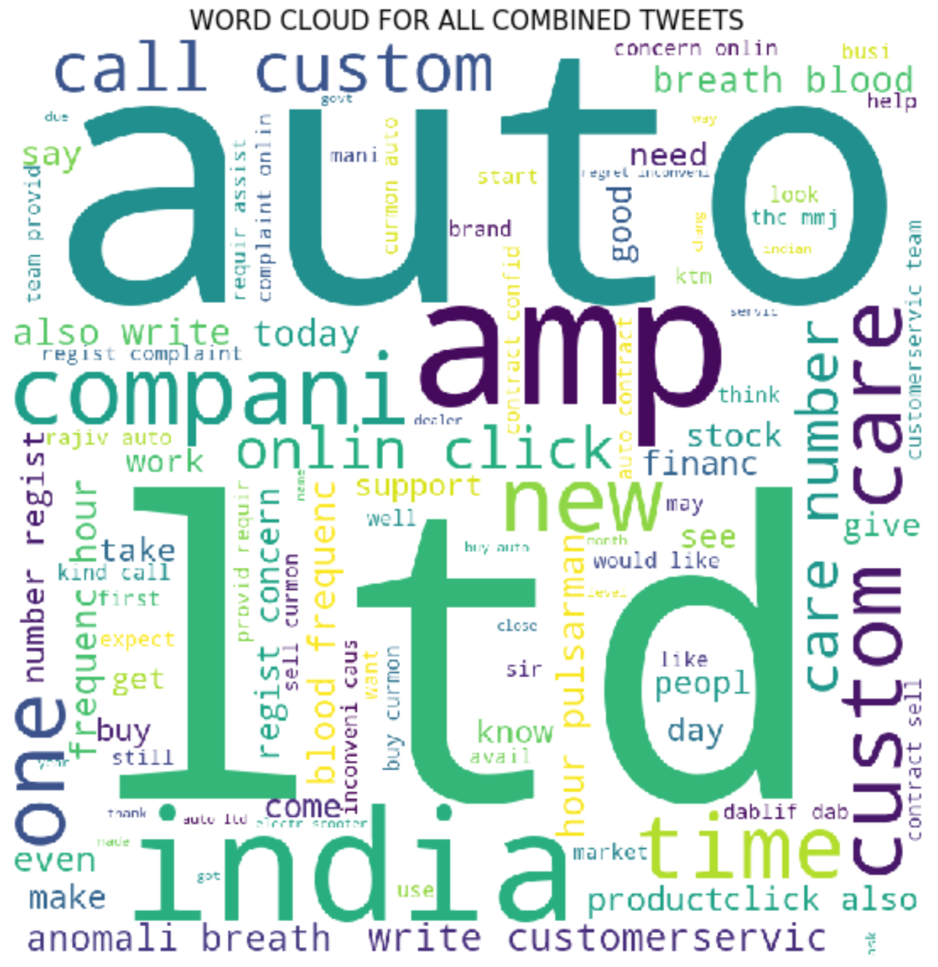
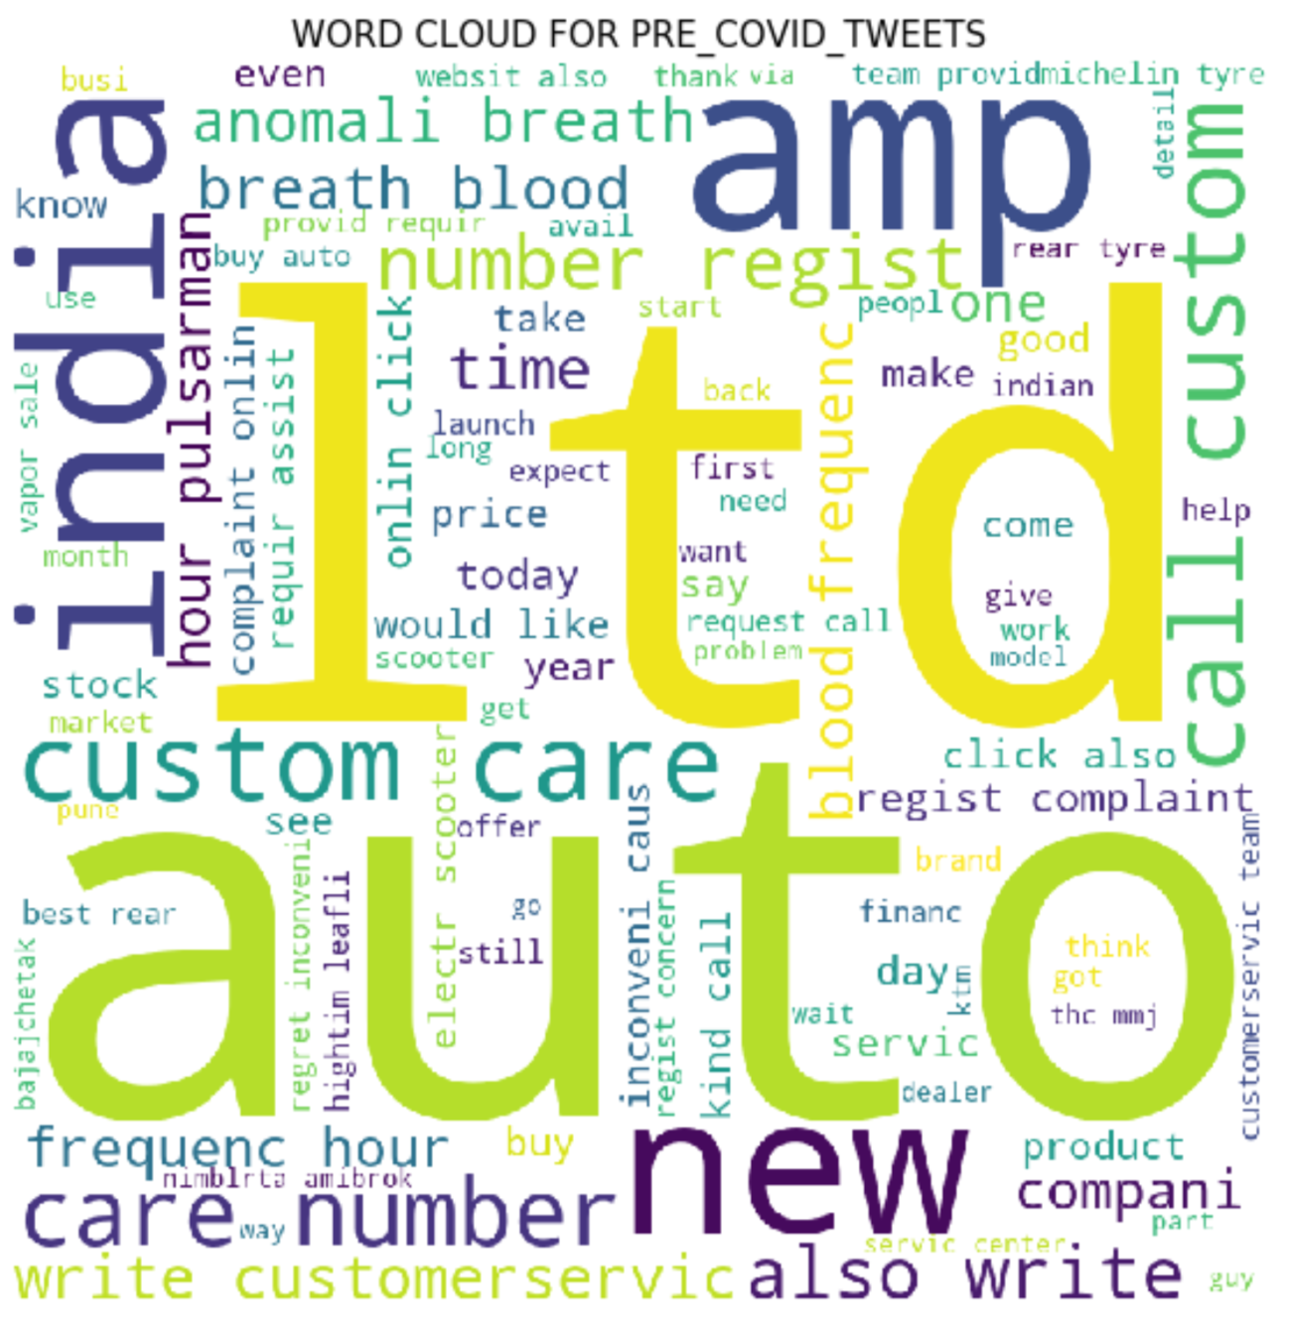
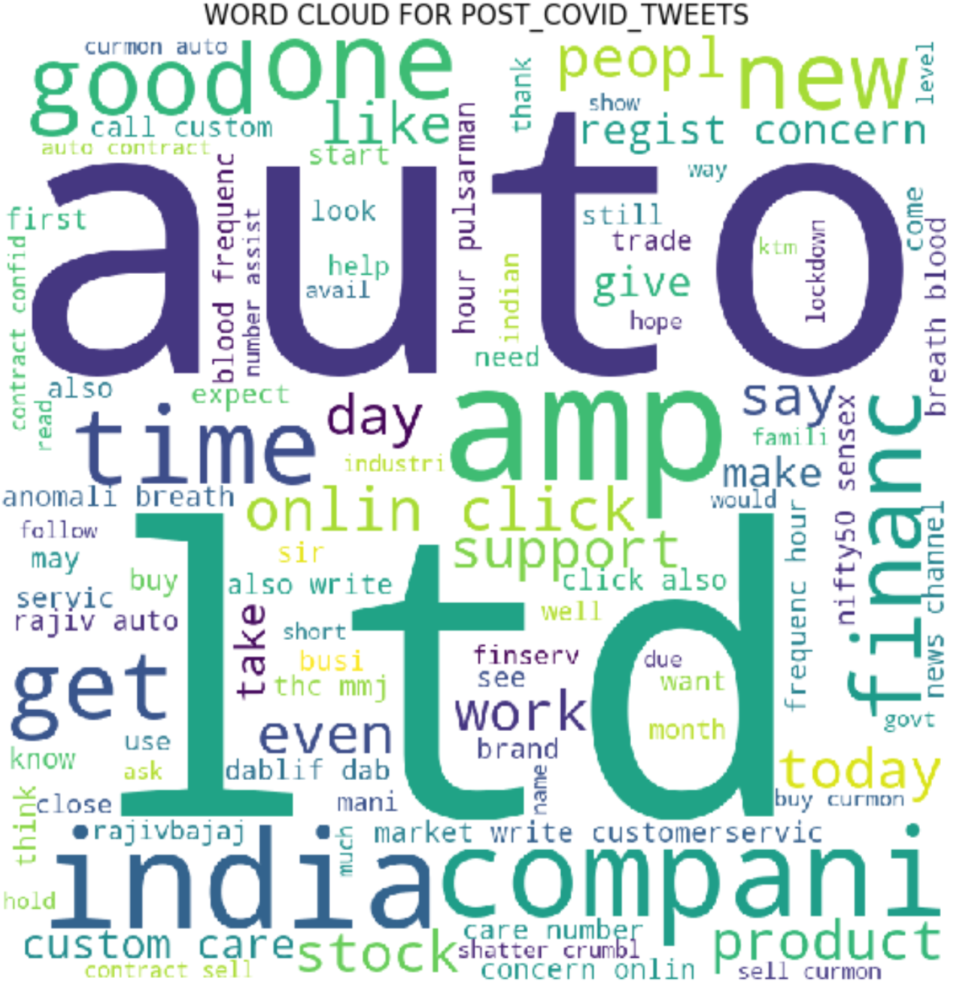
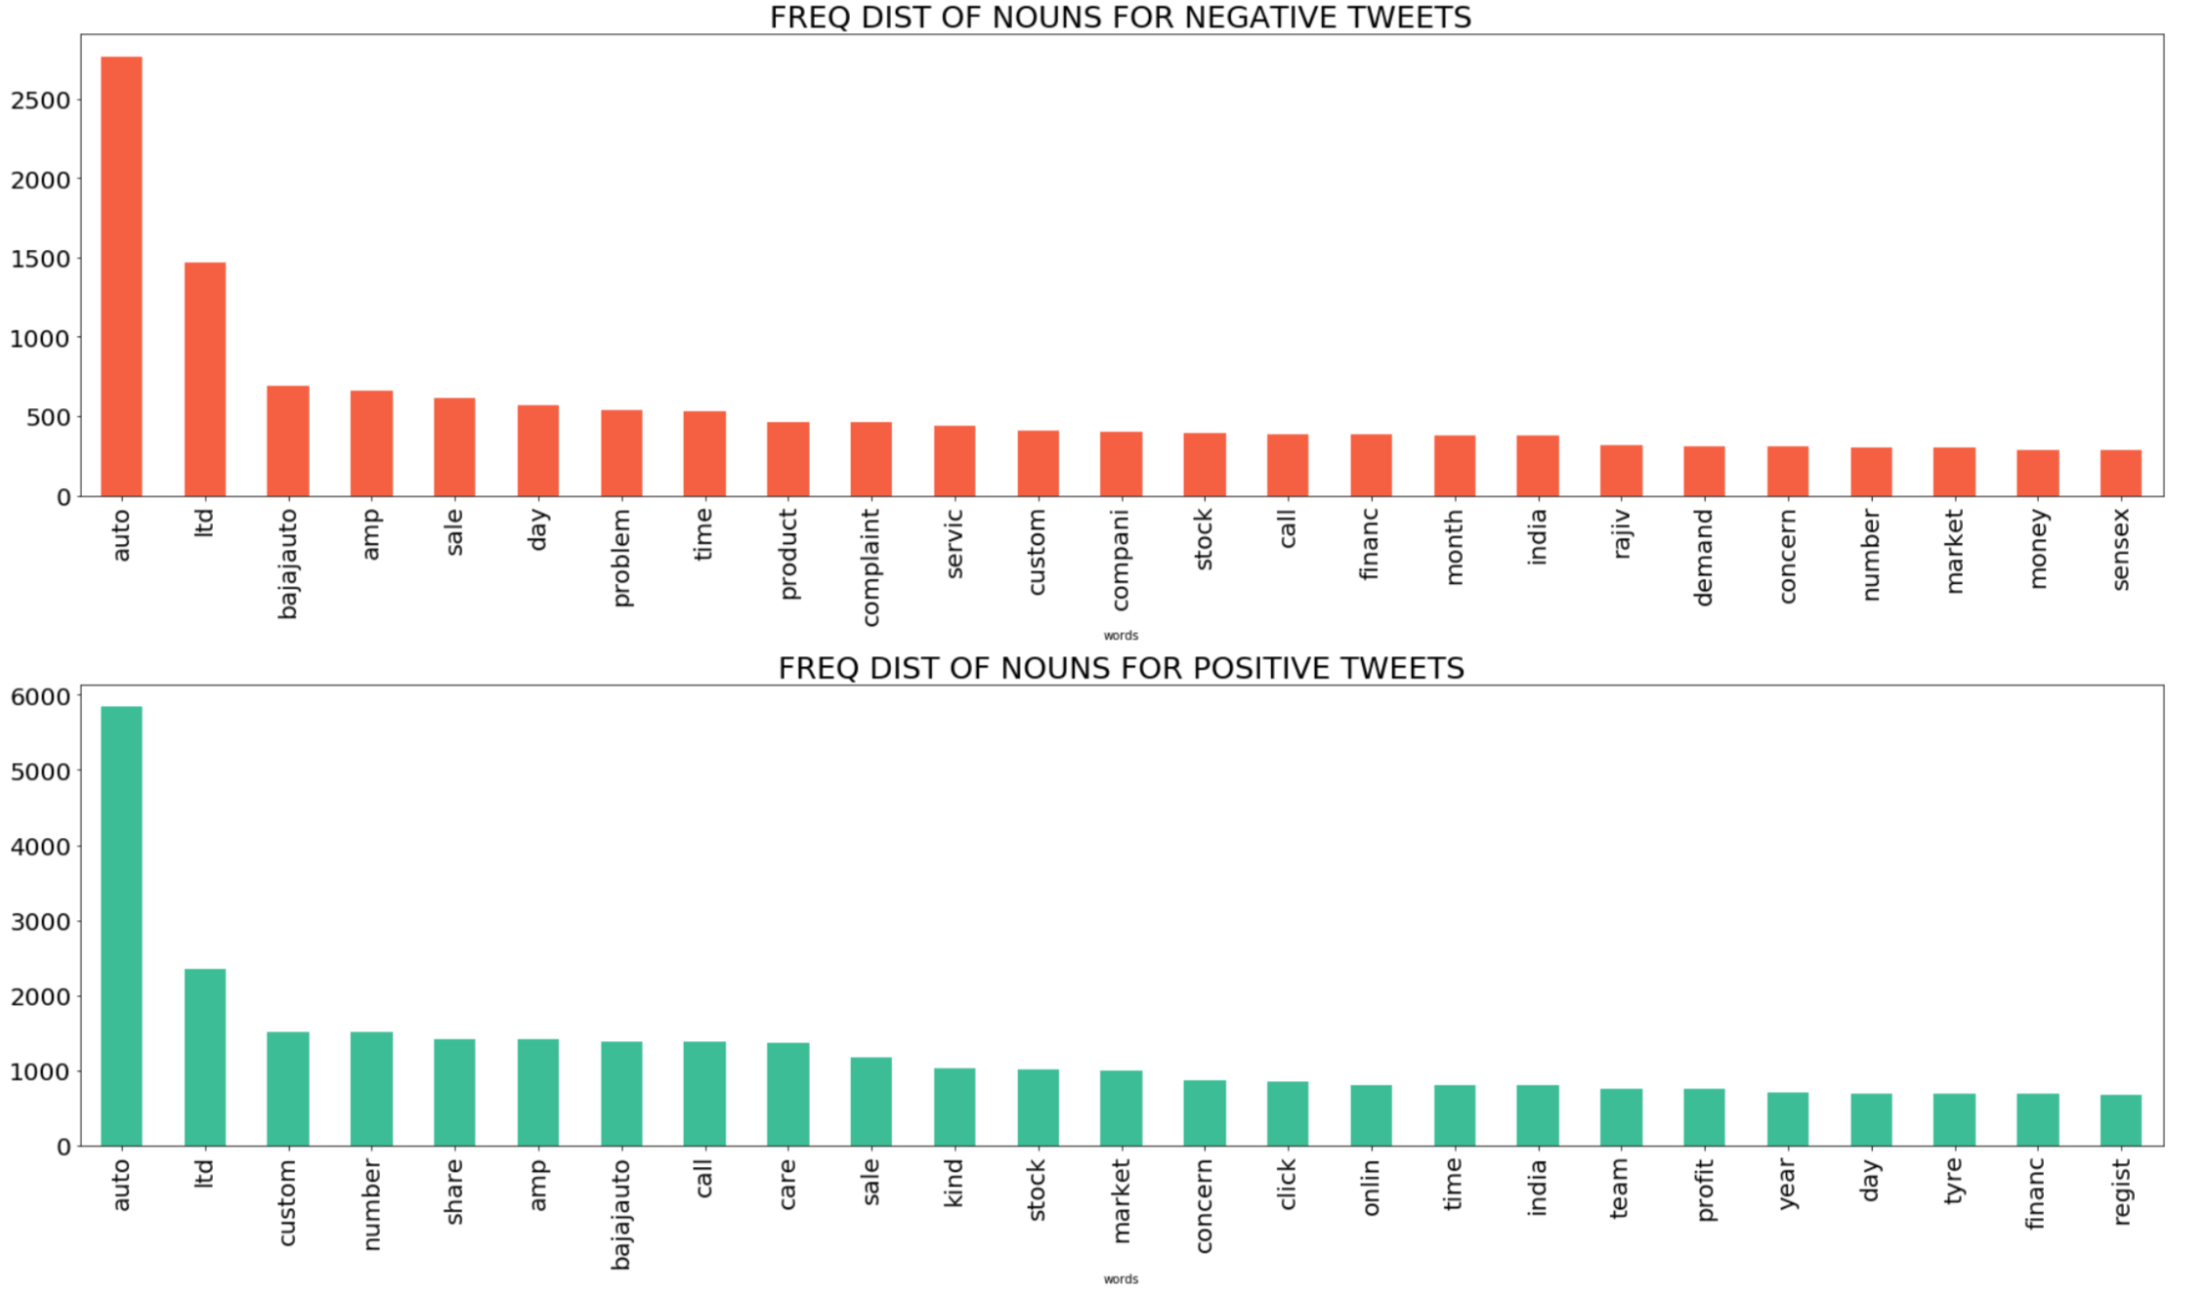
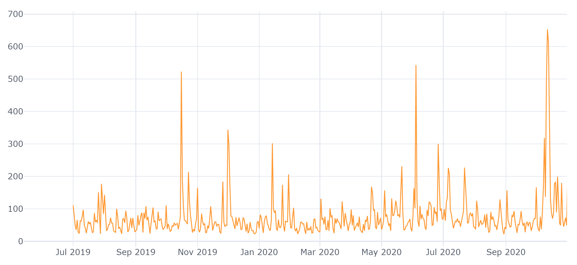
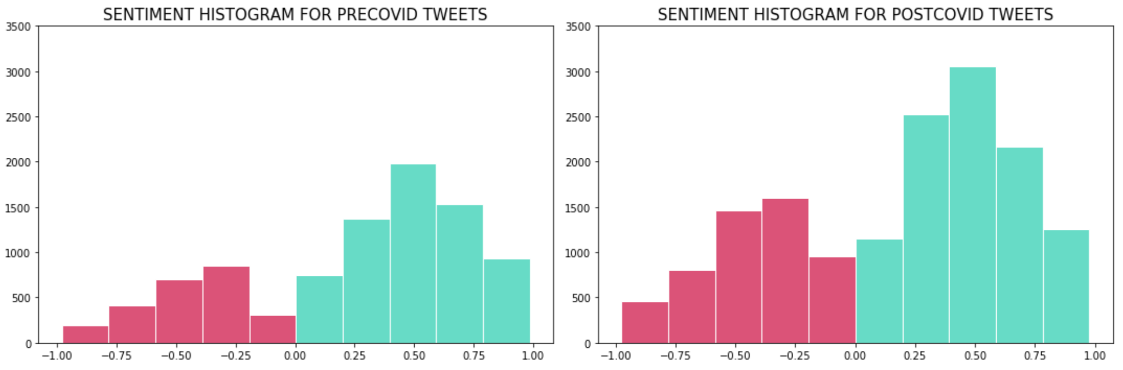
Bajaj Auto – Twitter Analysis (2)
CUSTOMER DAILY TWEET COUNT
Key Observations
There is decline in sale comparing Q1 2020 comparing Q1 2019 – as country was under lockdown and containment zone
Post Covid: company could gradually improve the operations.
Some of popular brands like Pulsar’s is doing Good in the market.
Number of Tweets are higher post Covid.

Slide 10
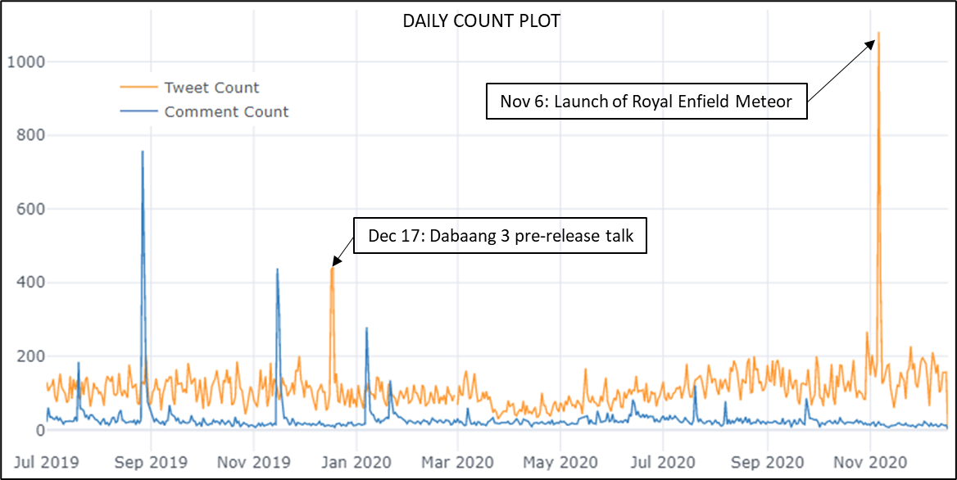
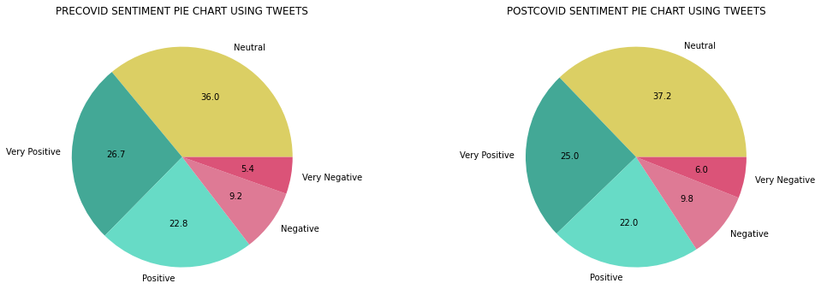
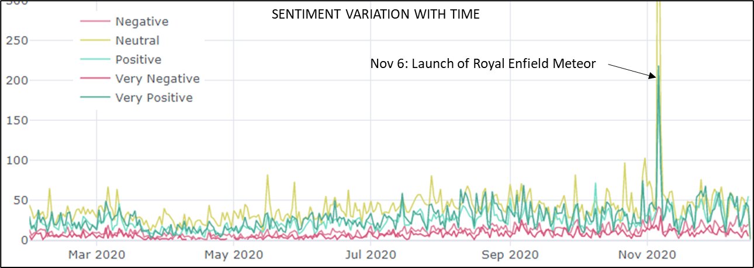
Royal Enfield – Twitter Analysis (1)
Bigram and Trigram analysis (Tweets and YouTube comments) Top 3 discussions
Positive | Negative
Looking forward to buy | Customer service Service center
Next adventure/trip | Kill switch
Keep up the good work | Big scam; fuel gauge; exhaust sound
Key Observations
Twitter activity related to Royal Enfield decreased at the onset of COVID, but bounced back to its pre-COVID level in the month of August.
Launch of Royal Enfield Meteor on Nov 6,2020 triggered an overwhelmingly positive response on Twitter. It is important to segregate tweets that are not exclusively related to Royal Enfield from others.
While some customers who bought a Royal Enfield model expressed satisfaction with their purchase, others have expressed great displeasure with regards to the customer service and treatment at service centres.
Overall, the twitter sentiment of Royal Enfield has remained positive and did not change by a significant amount due to COVID.

Slide 11
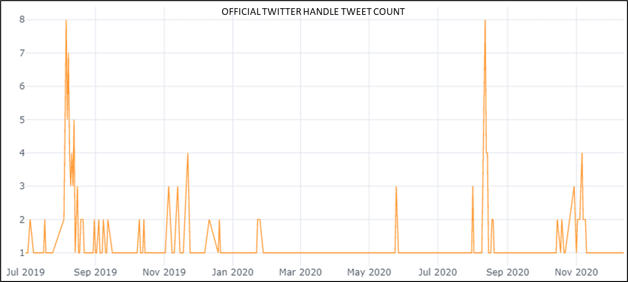
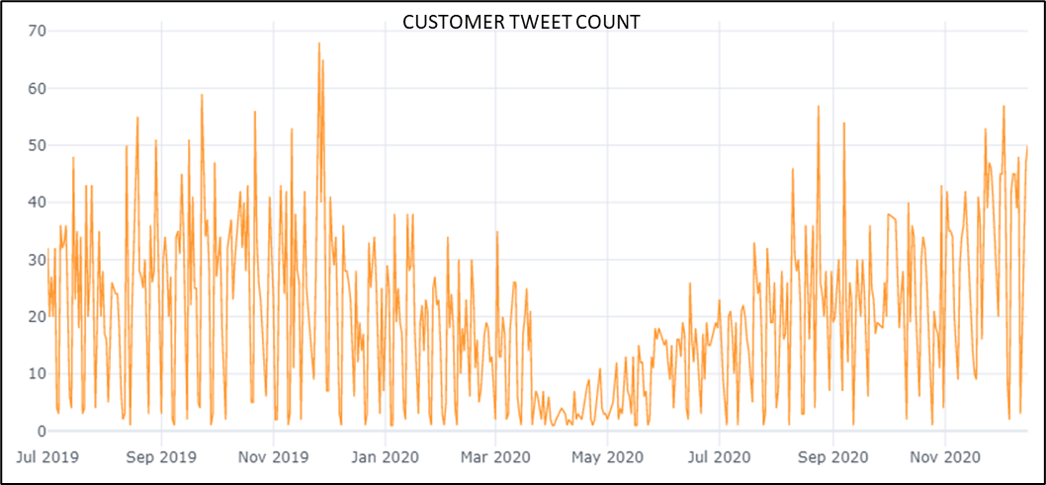
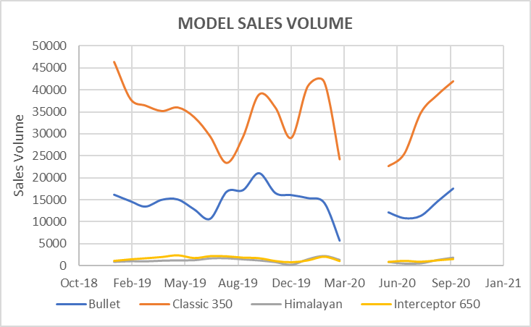
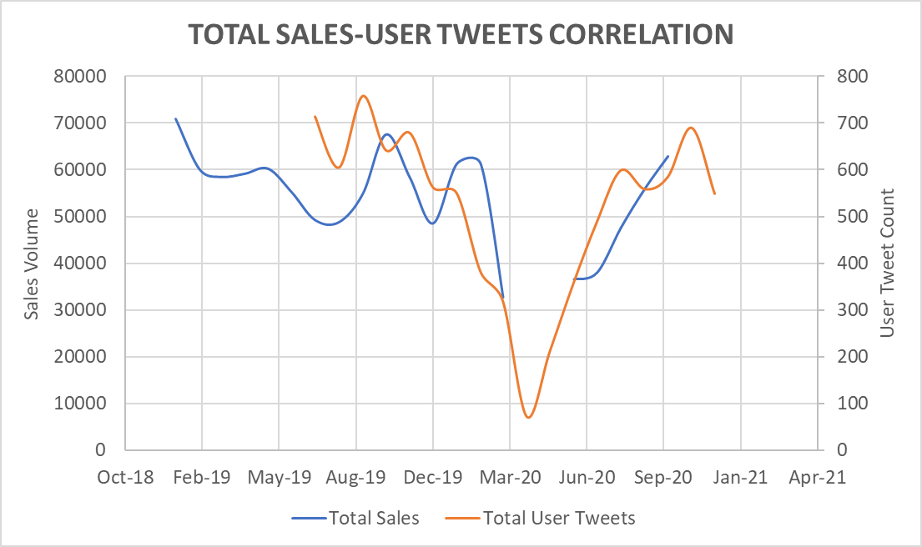
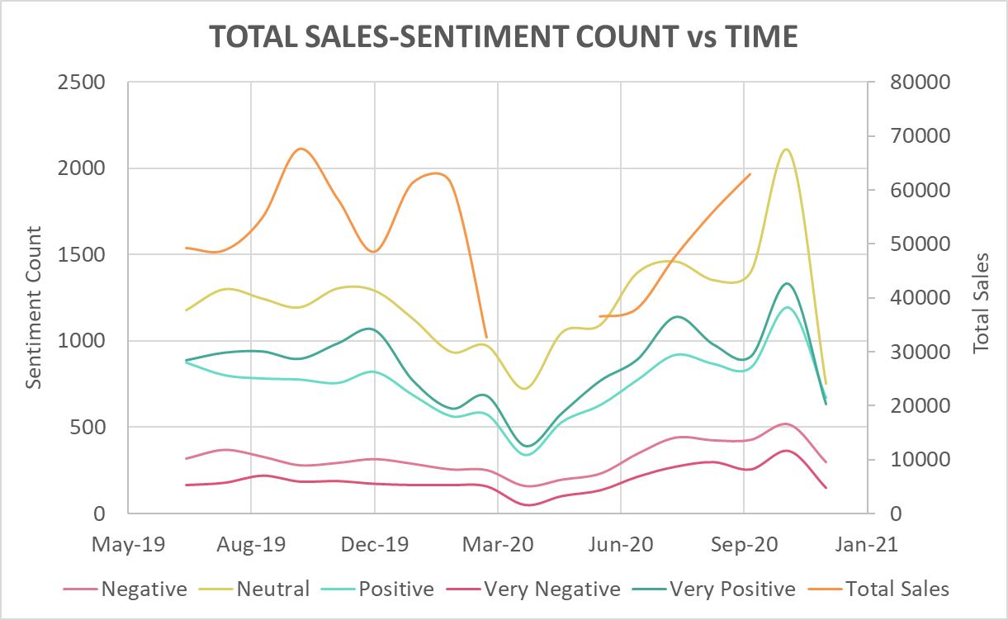
Royal Enfield – Twitter Analysis (2)
Top 3 market messaging hashtags
#ridepure
#puremotorcycling
#mybullet
Top 3 customer hashtags
#ridepure
#stayhome
#puremotorcycling #royalenfieldtwins
Top 3 model hashtags
#bullet
#classic350
#himalayan #interceptor650
Key Observations
Except for RE Bullet and RE Classic 350, individual model sales volume seems to be correlated with its corresponding twitter hashtag count.
Individual model hashtags are rarely used in market messaging through Royal Enfield’s official twitter handle.
Whereas market messaging on the Royal Enfield’s official twitter handle has been minimal (<10), increasing number of customers have used the official twitter handle to share their views or concerns.
Total sales and tweets from customers who mentioned official twitter handle seem to be strongly correlated.
Plotting total sales and sentiment count does not yield meaningful results.

Slide 12
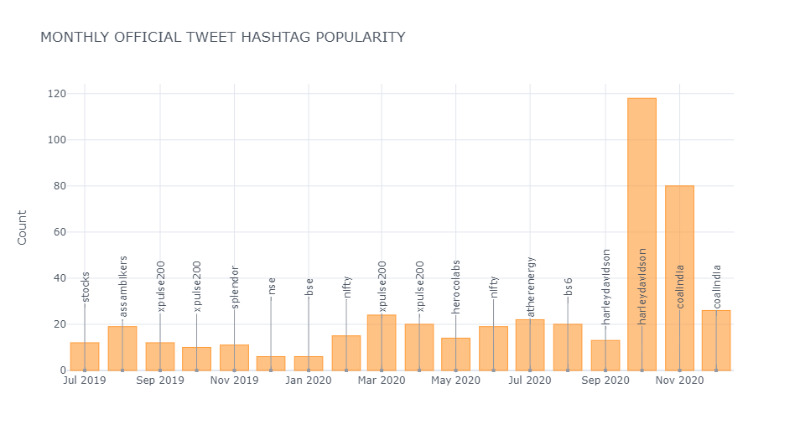
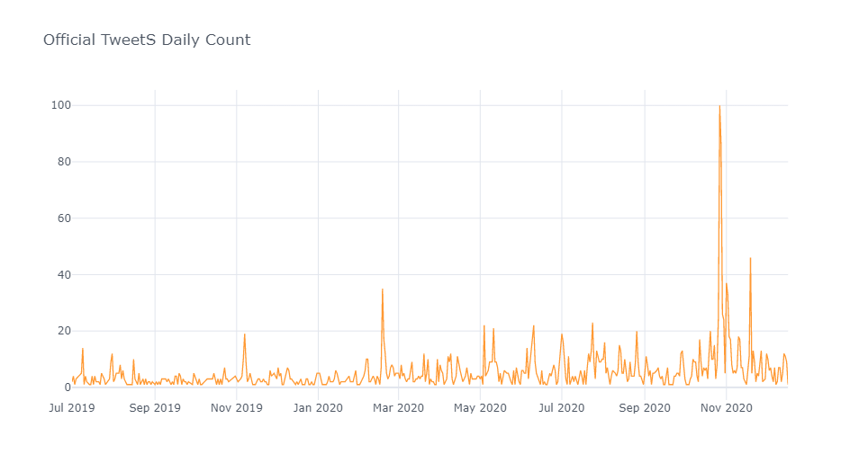
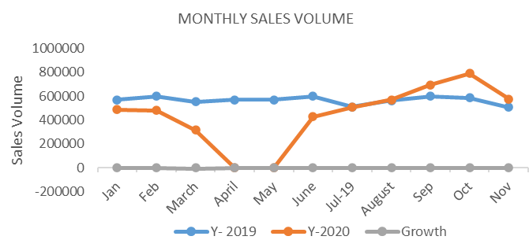
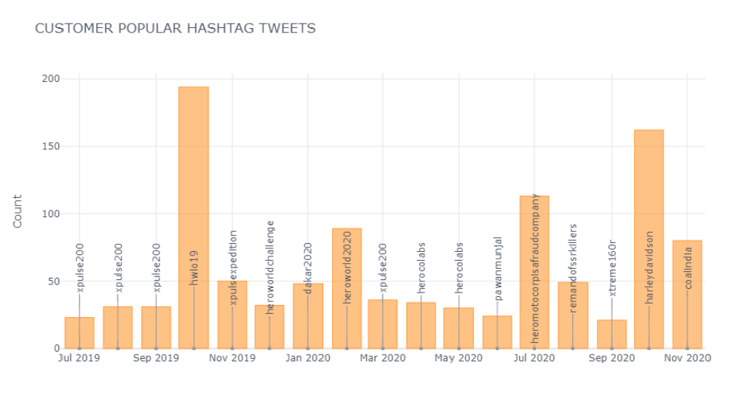
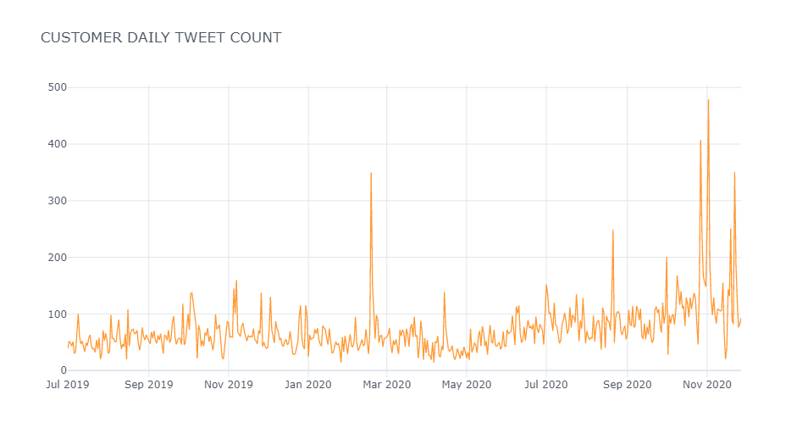
Hero Motocorp – Twitter Analysis (1)
MONTHLY OFFICIAL TWEET HASHTAG POPULARITY
OFFICIAL TWEET DAILY COUNT
Top 3 Popular market messaging hashtags Popular customer hashtags
#HarleyDavidson II #HarleyDavidsonII
#Herocolabs II #Fraudcompany
#XpulseII #Xtreme160r
CUSTOMER POPULAR TWEET HASHTAG
CUSTOMER TWEET DAILY COUNT
Key Observations
Pre Covid: Tweets from Official handle mostly talks about BS6 and other popular brands of the company Splendour Plus, Glamour 6
Official Tweeter count is more in the festive season of Oct and Nov due to launch of new vehicle segments.
Customers using official Handle are more active in March and then again onset of festive season , i.e, from Sep to December and talks about various campaigns
Post Covid :Official campaigns from Hero MotoCorp is basically focussed towards college student by Launching its Hero Campus Challenge S6,HeroClabs.
Company has collaborated with Harley-Davidson for selling and servicing Harley-Davidson Motorbikes which is also trending .
Monthly Sales volume for Pre_covid and Post_covid era, which depicts that there is an increase in sales due to pandemic as people are preferring personal transportation

Slide 13
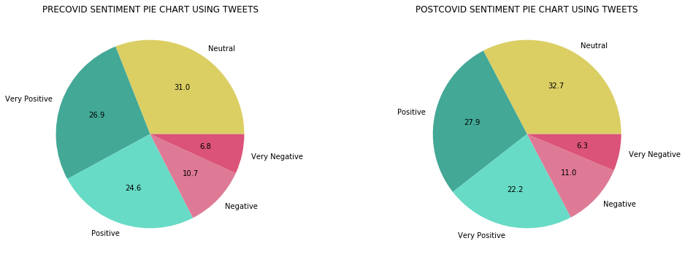
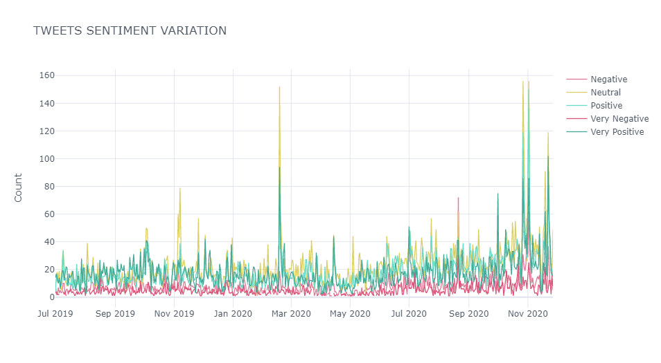
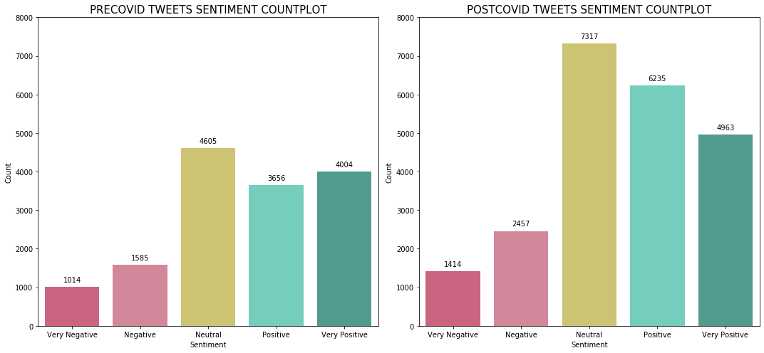
Hero Motocorp – Twitter Analysis (2)
TWEET SENTIMENT VARIATION WITH TIME
Bigram Sentiment Analysis (Tweets and YouTube comments) Top 3 discussions
Positive | Negative
Nice review | Tyre issues
Good speed | Worst service
White color | Unpleasant experience
Key Observations
Tweets were categorized into Pre_covid and Post_Covid tweets and was used to analyse consumers sentiments based on the covid era
Topic modelling was one of the key approaches that was used to derive the meaningful insights from the topics to learn about the consumers sentiment.
Graphical representation is used to study the Pre_covid and Post_covid sentimental behaviour of customers
As an observation there is slight increase of 1% in Positive sentiments in Post_covid era, simultaneously there is a decline of 2.4% in Very Positive sentiments.
In the month of March Sentiment Variation seems to be high, also same trends is observed in the Festive season of Oct Nov. One key observation that most of the sentiments are positive .

Slide 14
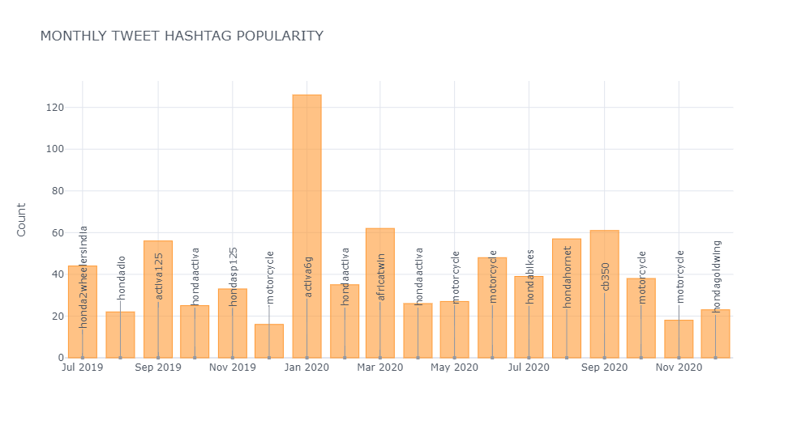
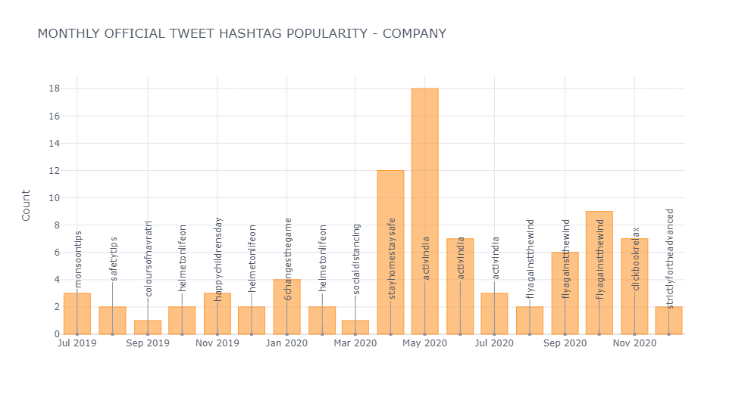
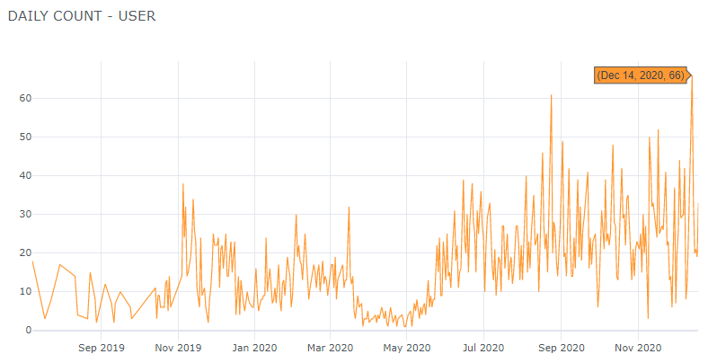
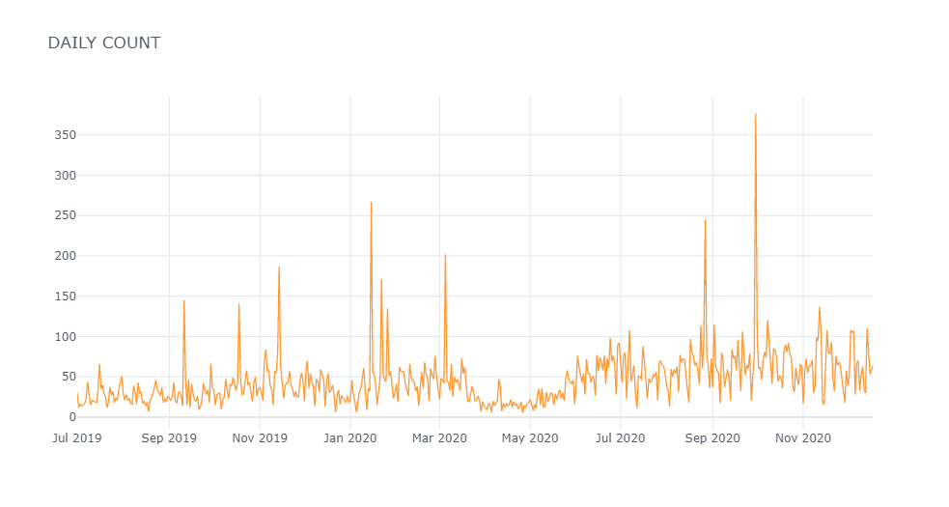
Honda Motorcycles – Twitter Analysis (1)
MONTHLY TWEET HASHTAG POPULARITY
MONTHLY TWEET HASHTAG POPULARITY - COMPANY
DAILY COUNT USER
DAILY COUNT
Key Observations
Pre-covid hashtag analysis talks about models like ‘Activa 6G’,’activa125’,’Dio’& ‘Africa twin’ as you can see in monthly tweet hash tag popularity
Pre covid-- Activa 6G launched in Jan 2020, because of laucnch there is little spike of tweets in Jan-2020.
Some launches of models like CD 110 Dream BSVI (Kuch kuch nahi…Sab Kuch Hai)& GRAZIA 125 BSVI happened in June 2020, but tweets were very less as you can see between may 2020 & July 2020
Post Covid : (July 2020)For strengthening contactless customer engagement in times of social distancing, Honda 2Wheelers India has announced the launch of its digital, secure and convenient ‘Online Booking’ platform.
These is some spike in tweets in Oct-Nov 2020 as there were some important launches of models like Honda Hornet 2.0 & Dio and by this time market is also mostly functional.

Slide 15
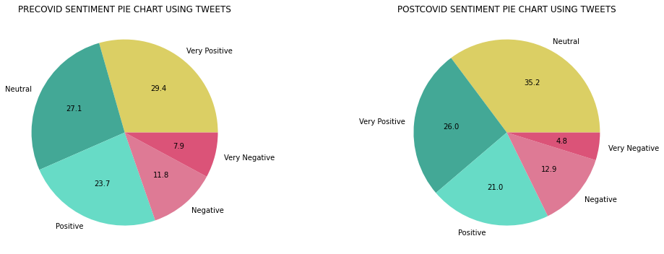
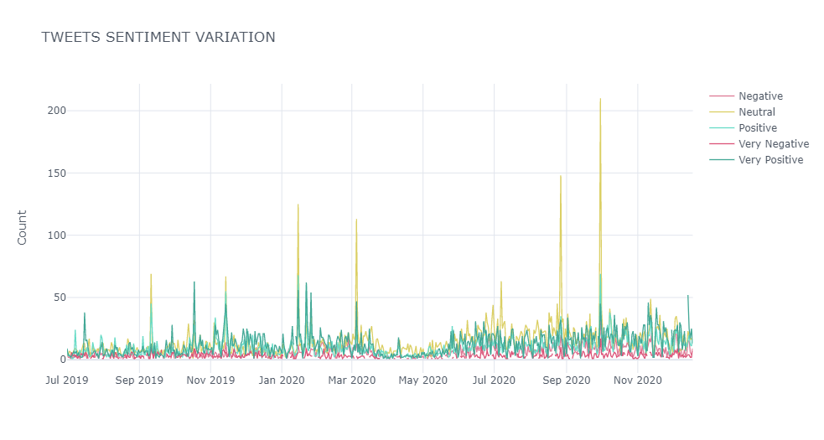
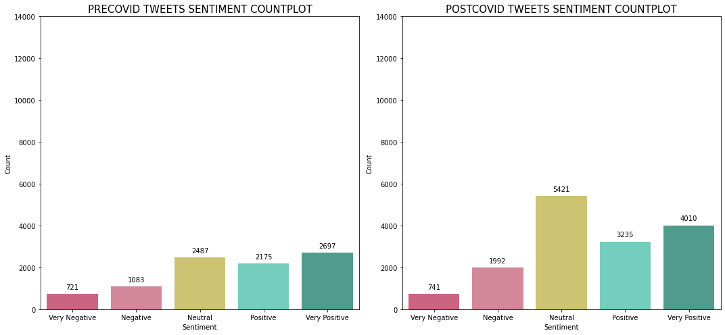
Honda Motorcycles – Twitter Analysis (2)
Bigram and Trigram analysis (Tweets) Top 3 discussions
Positive | Negative
Buy Activa | Disappoint customer service
Good experience | Deeply regret
Check soon | Service center
Key Observations
Categorization of tweets into Pre_covid and Post_Covid was done to analyse end users sentiments.
Pie-charts & count plots of pre_covid & post_covid is used to analyse the sentiments behaviour of customers.
As you can see in ‘Tweet Sentiment Variation’ - Small spike of tweets in Nov 2020 because of launch of Honda Hornet 2.0 & Dio triggered positive response on Twitter.
Same trends is observed in the Festive season of Oct Nov and key observation is that most of the sentiments are Neutral, positive & Very Positive during festive season.
If we see overall, the twitter sentiment of Honda motor bikes has remained positive and did not change by a significant amount due to COVID .

Slide 16
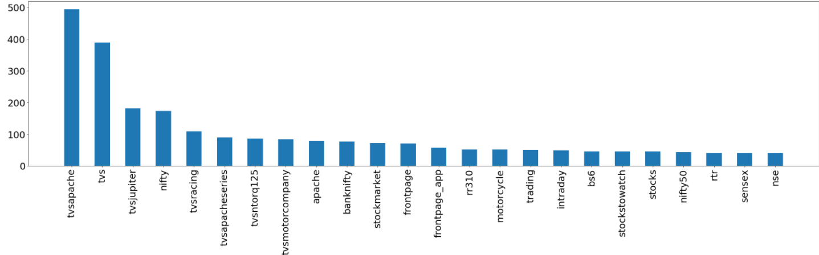
TVS Motors – Twitter Analysis (1)
Phase 1 – Hashtag Analysis (April 2019 – Oct 2020)
Methods: Web Scraping, Hashtag Analysis
Key Observations
Pre Covid: Tweets from Official handle are talks about all range of vehicles which TVS have in market and categorization also seen between urban and rural
Post Covid : Tweets are mostly talking about only couple of models and which has highest market from beginning.
Especially on sports range (Apache) have more tweets related to quality, also TVS tried to use twitter as media to showcase social responsibility towards Covid-19

Slide 17
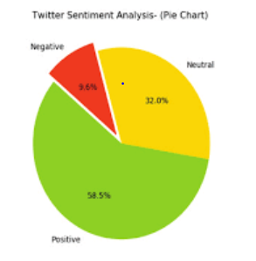
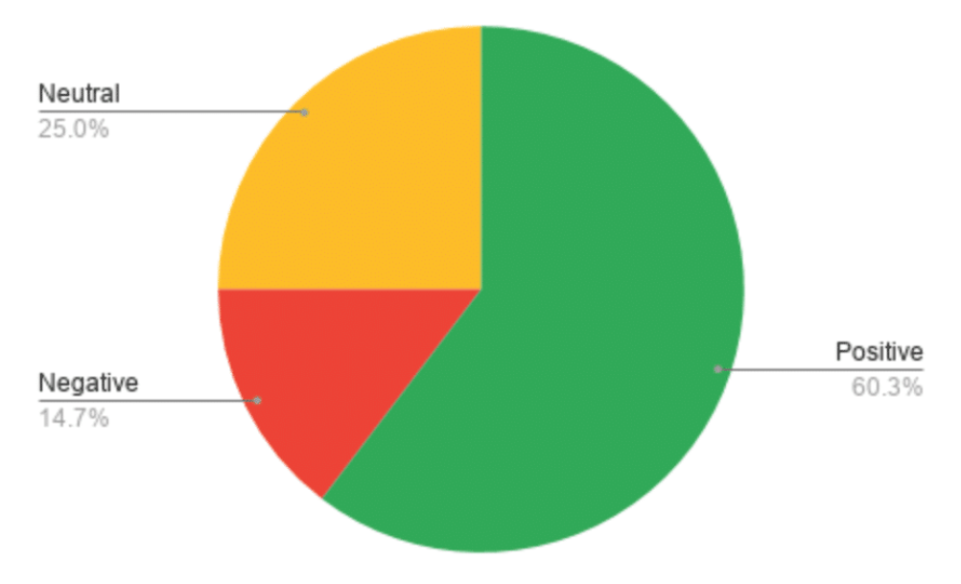
TVS Motors – Twitter Analysis (2)
Phase 2 – Tweet Analysis using Sentiment Analysis (May 2019 – Oct 2020)
Pre covid
Post covid
Key Observations
Consumer view on TVS motors before and after covid not so variance in company sentiment, TVS company market view is more of rural than urban as per views
The variation of consumer sentiments were then analysed over the target period (Pre-Covid and Post-Covid)
Percentage of neutral views have change and consumers started valuing their money when choosing the brand

Slide 18
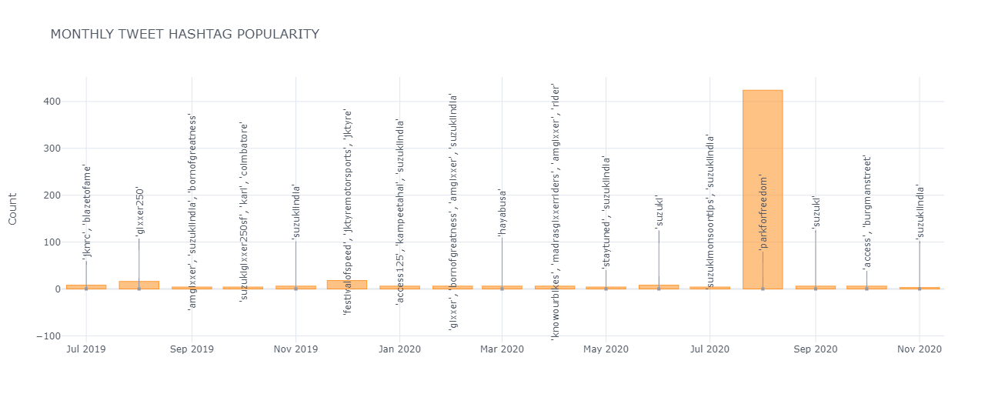
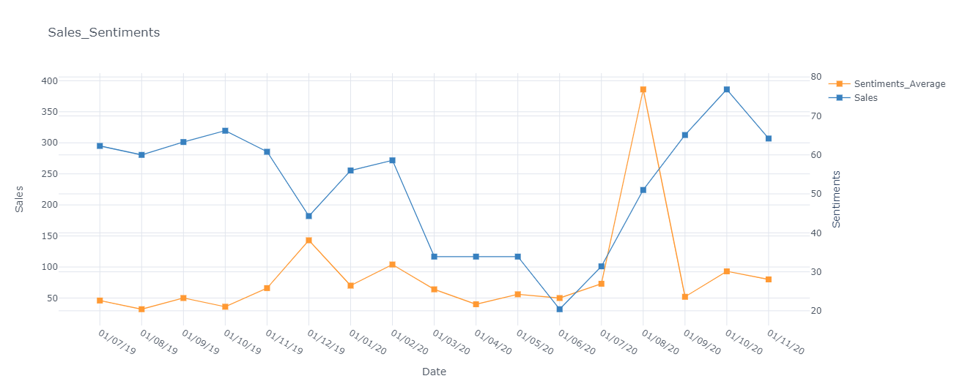
Suzuki Motors – Twitter Analysis (1)
Phase 1 – Official Hashtag Analysis (Jul 2019 – Nov 2020)
MONTHLY OFFICIAL TWEET HASHTAG
COMPARISON OF SALES AND CUSTOMER SENTIMENTS
Methods: Web Scraping, Hashtag Analysis
Key Observations
Official messaging from Suzuki, by and large, was aligned to its marketing campaigns. Some of the campaigns like ‘Born of Greatness’ and ‘amgixxer’ were the prominent ones during pre-Covid period.
The focus of these campaigns, however shifted to CSR branding with emphasis on Covid warriors such as the campaign ‘ParkForFreedom’, during the post-Covid period.

Slide 19
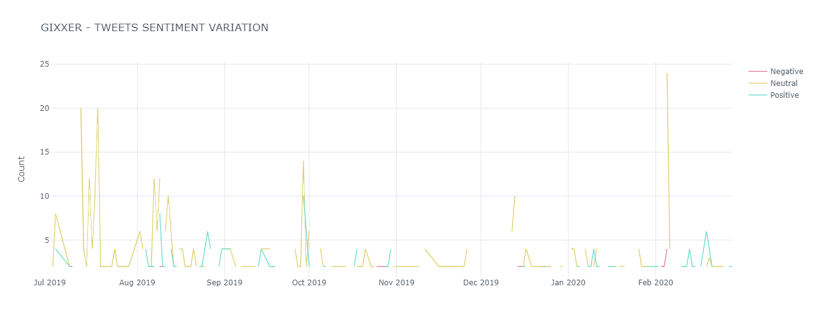
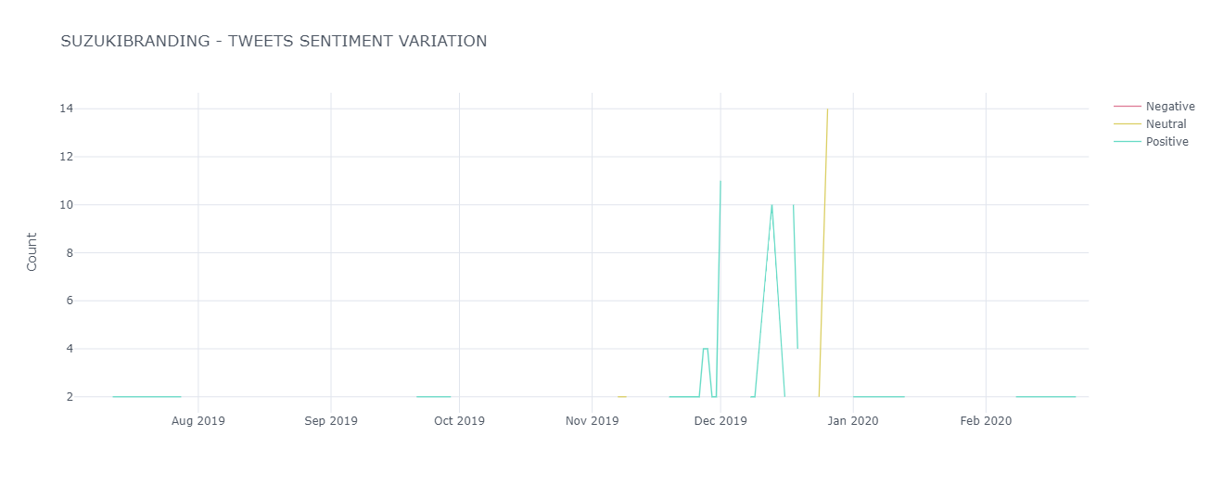
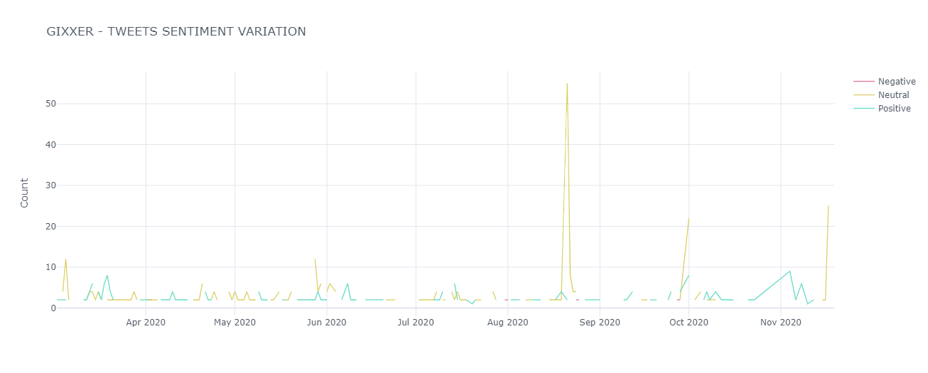
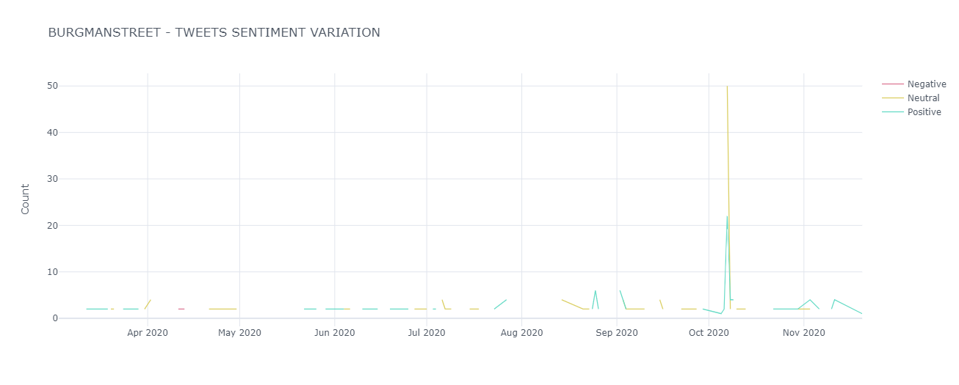
Suzuki Motors – Twitter Analysis (2)
Phase 2 – Rest of the Tweet Analysis using Topic Modelling & Sentiment Analysis (Jul 2019 – Nov 2020)
Pre-Covid
Post-Covid
Key Observations
Rest of the tweets were analysed to derive and understand the consumer perception and were categorised into meaningful topics.
These twitter discussions were intuitively grouped into major topics
The variation of consumer sentiments were then analysed over the target period (Pre-Covid and Post-Covid)
Company’s latest motorbike – ‘Gixxer’ was the most trending and popular discussion topic for the twitter crowd.The overall sentiment of the population was also very positive throughout the period.

Slide 20
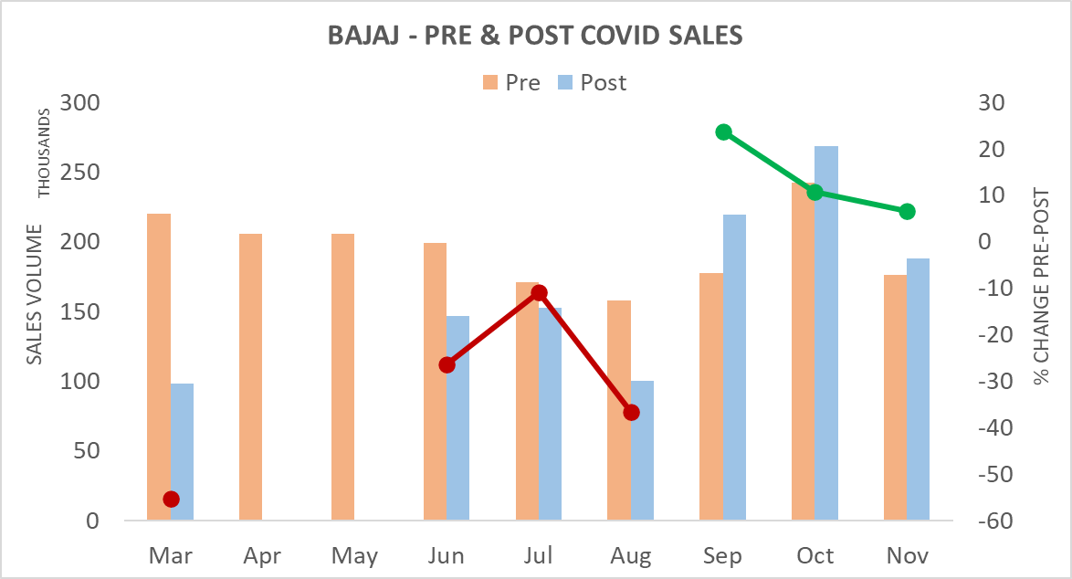
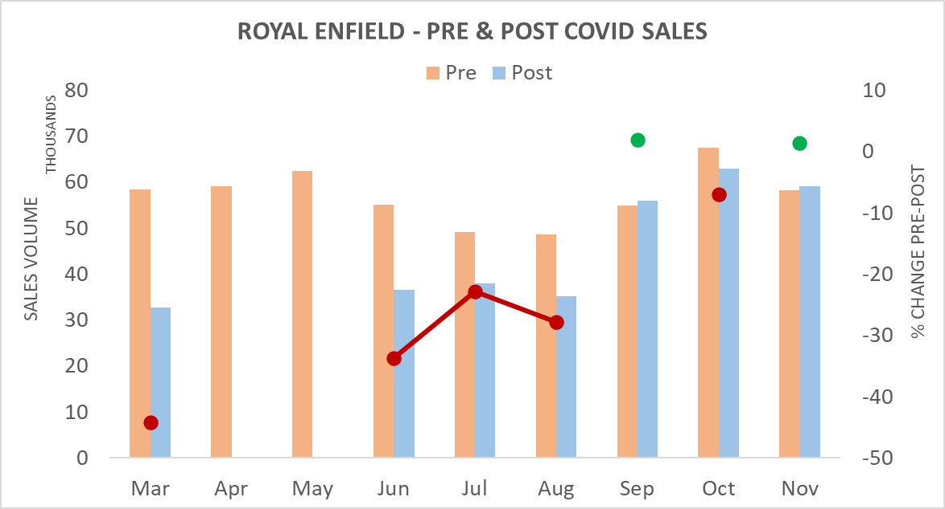
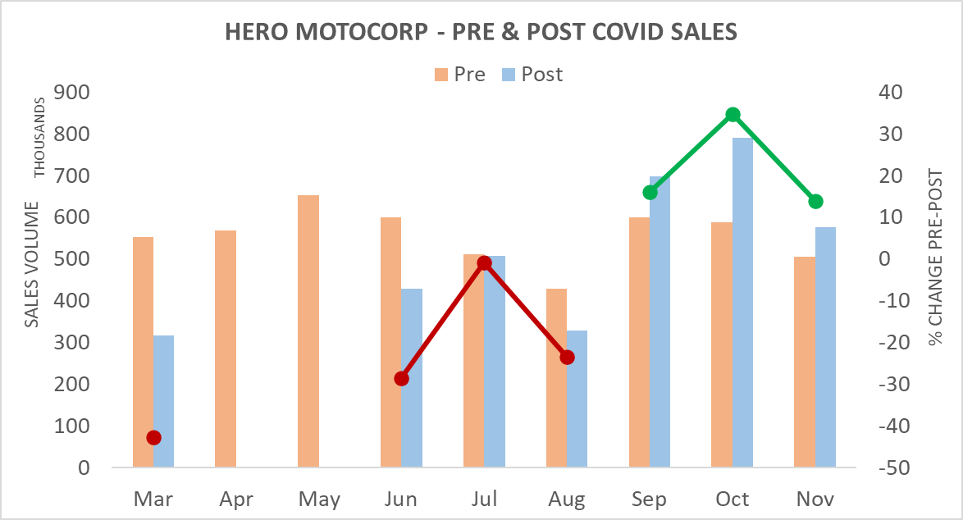
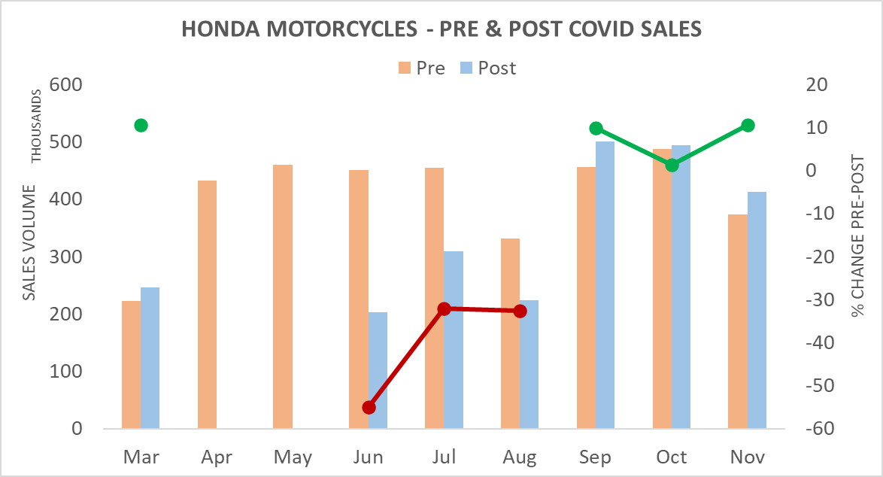
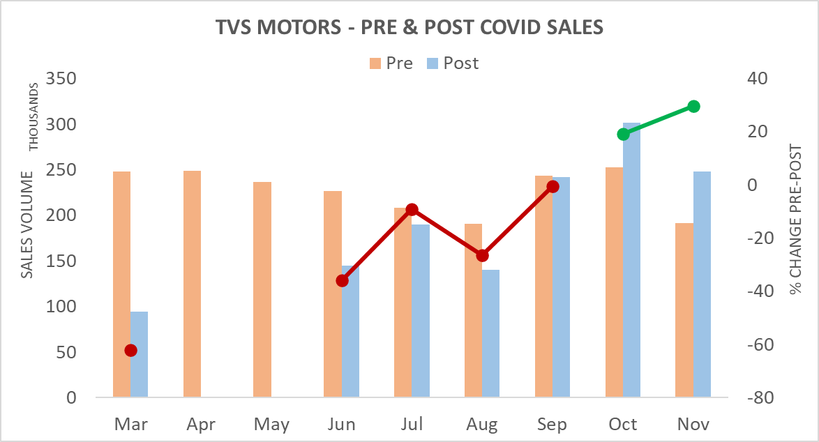
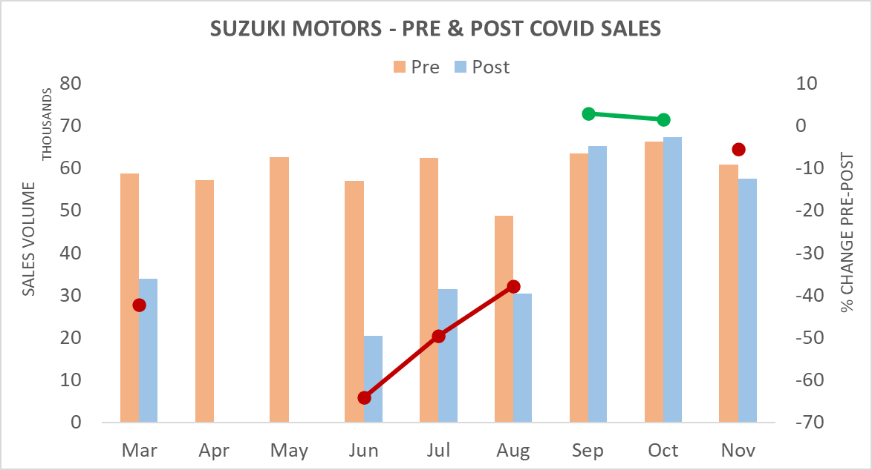
Conclusions (1)
Pre- and Post-COVID Sales Volume Analysis
Key Observations
Majority of the brands have outperformed their previous year sales since September 2020. It is interesting to note that September has also been the month when the tweet volume for most brands reached pre-covid levels.
Although most brands outperformed their previous year sales since September 2020, sales volume has not stabilized yet.
% change in sales volume of Royal Enfield and Suzuki Motors has been hovering near ‘0’ for the past three months.
Since September, Hero Motocorp and TVS Motors have clearly outperformed other brands in terms of sales volume.
Honda Motorcycles is the only brand that had a positive % sales volume change for the month of March.

Slide 21
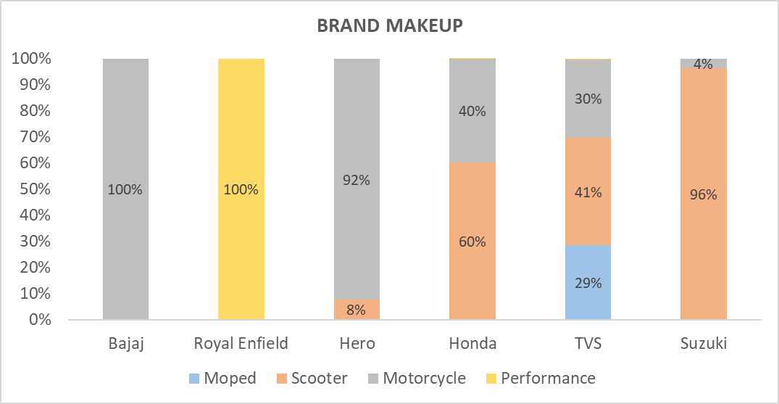






Conclusions (2)
Royal Enfield
Hero
Honda
Bajaj
TVS
Suzuki
Key Observations
Market position of Hero, Honda, Bajaj, and Honda did not change due to COVID. Although Royal Enfield’s and Suzuki’s market position has relatively gone back and forth, it remained well below other major brands. We anticipate similar trends continuing for the next three months.
The market campaigning of some of the brands were aligned with public sentiments as projected in our analysis. The brands that were quick to adopt public perception also witnessed increased volume in sales – Gixxer (Suzuki); Hornet (Honda); Xpulse (Hero).
Model popularity did not get affected by COVID. Although Honda Activa lost its dominance temporarily to Hero HF Deluxe before the onset of COVID, its regained its top position in September. Jupiter is no longer the most popular TVS scooter in the market. It has been overtaken by XL Super Moped.

